Slide 1
FINA4380
Supplementary Notes

Slide 2
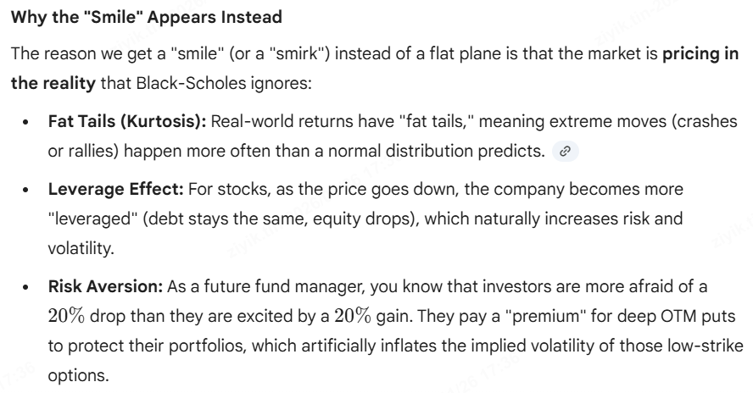
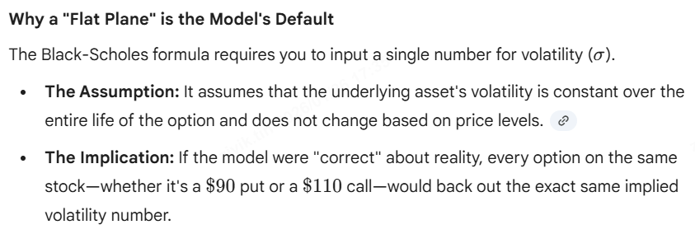
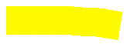

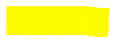
Risk-Neutrality of Black Scholes Model
Risk-neutral = drift becomes risk-free rate

Slide 3
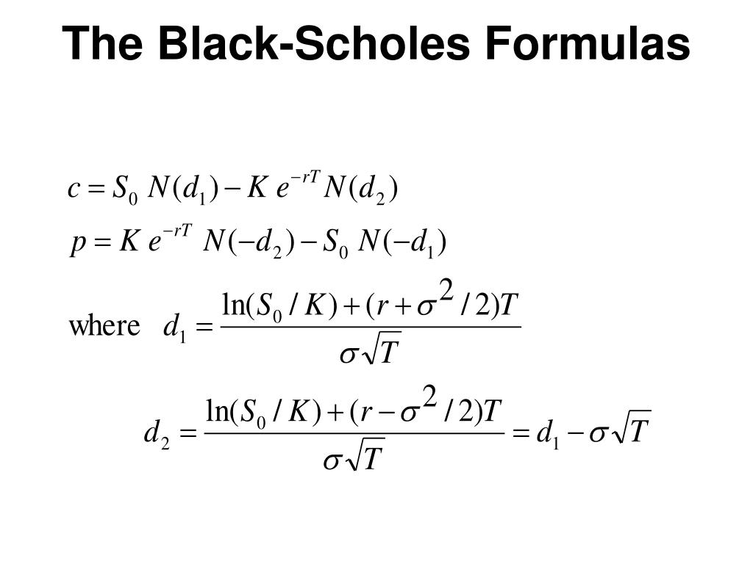
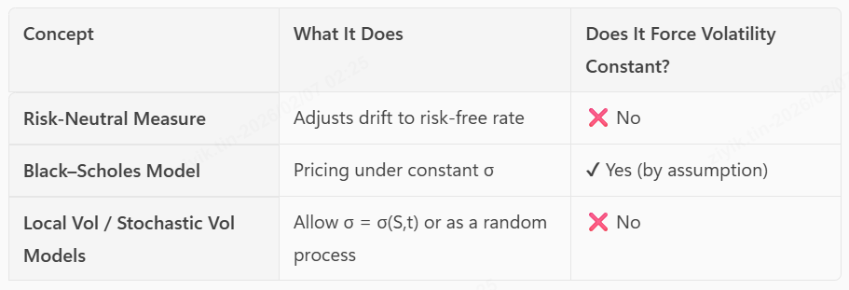
It’s BS that force constant vol, not because of risk neutral

Slide 4
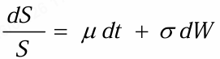
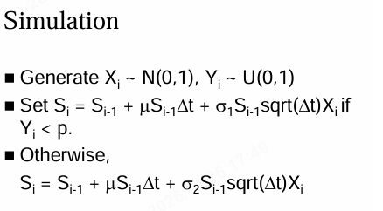
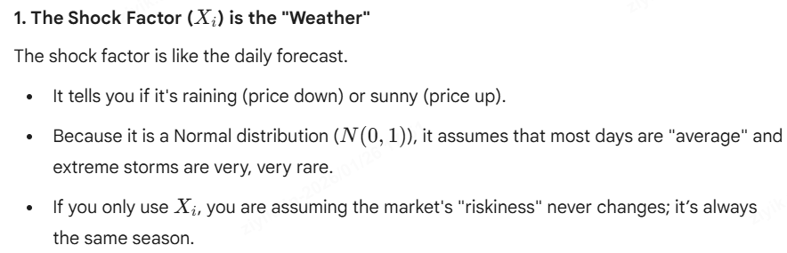
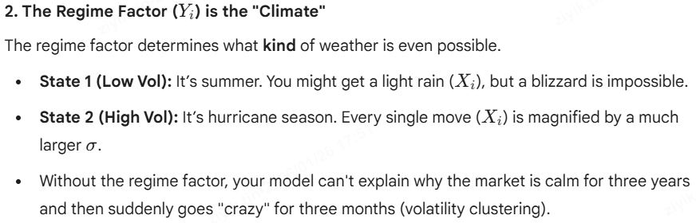
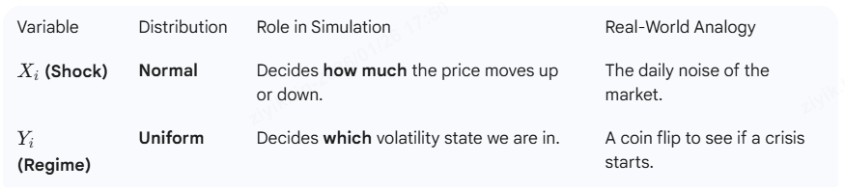

Random Volatility Model

Slide 5
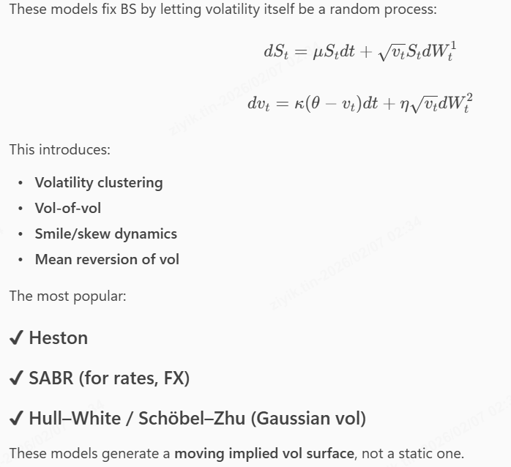
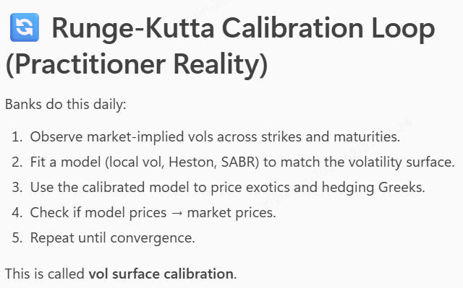
Stochastic Volatility Model
After you pull market vol data, you choose a model → guess parameters → compute model implied vols → compare to market implied vols → adjust parameters → iterate until both match.

Slide 6
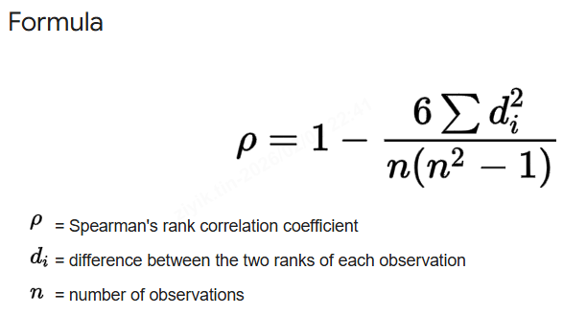
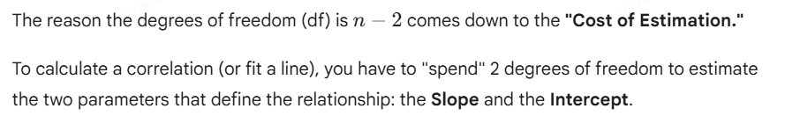
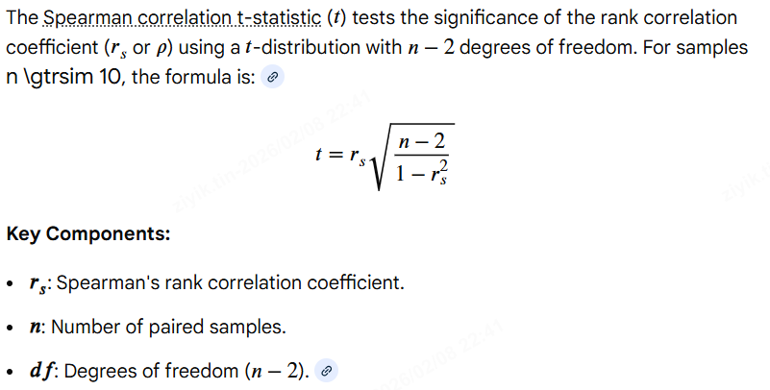
Spearman Correlation

Slide 7
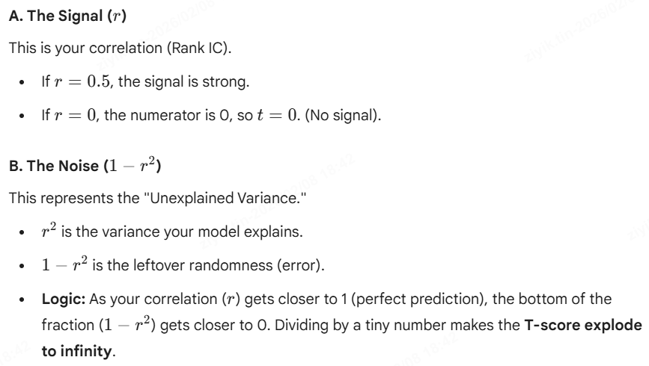
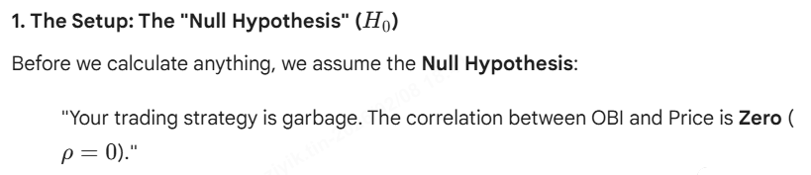
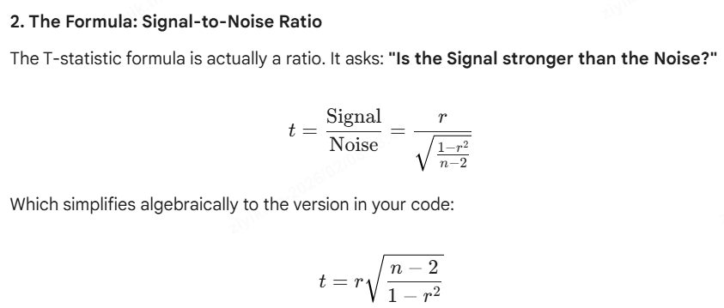
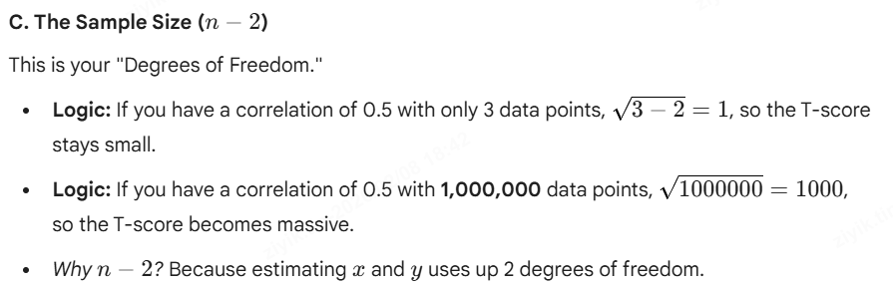
t statistic for Spearman Correlation
…

Slide 8
ORDER FLOW ANALYSIS
Supplementary Notes

Slide 9
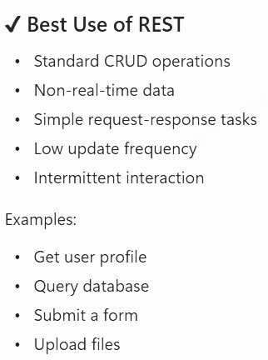
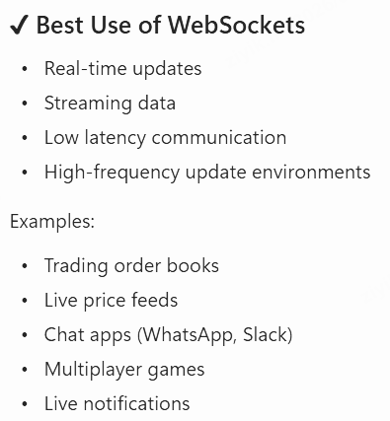
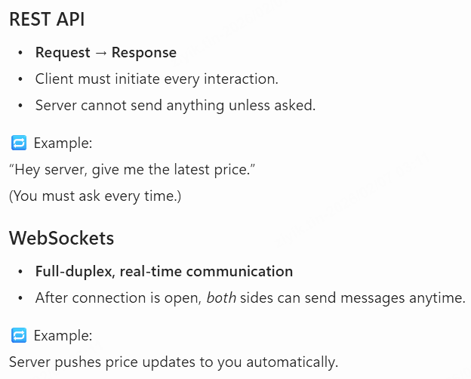
Websockets VS Rest APIs

Slide 10
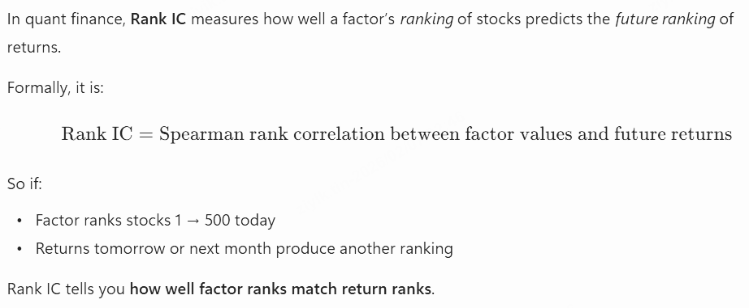
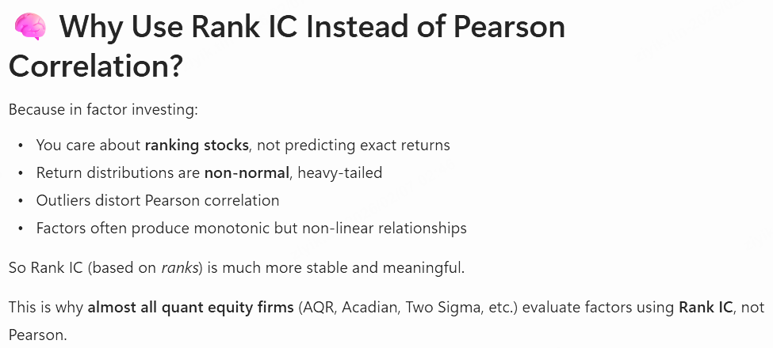
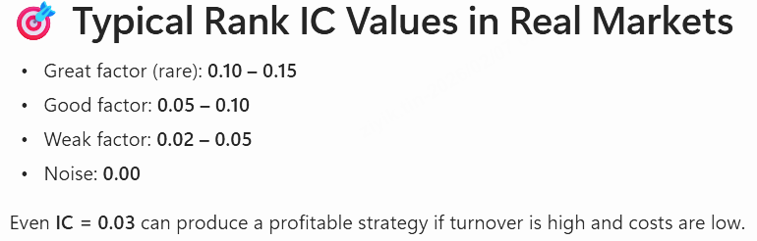
Rank Information Coefficient (RIC)
RankIC tells you how well today's order flow imbalances predict tomorrow’s (or next 5 minutes’) cross-sectional returns.

Slide 11
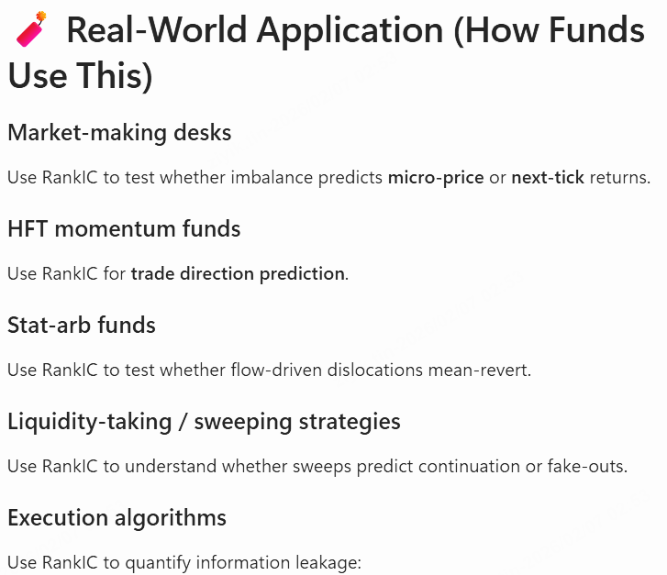
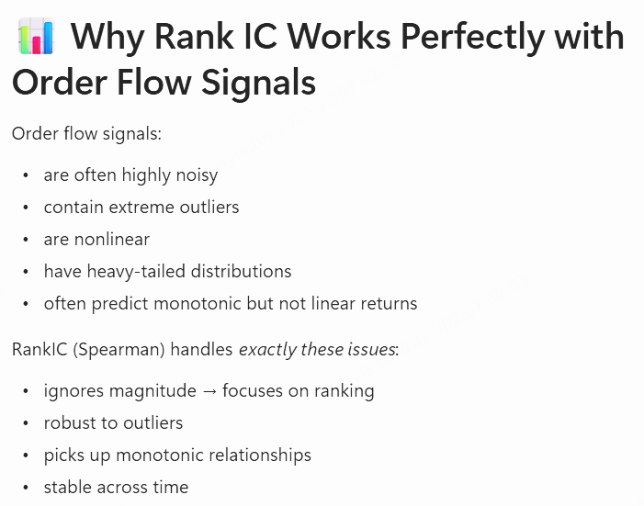
Rank Information Coefficient

Slide 12
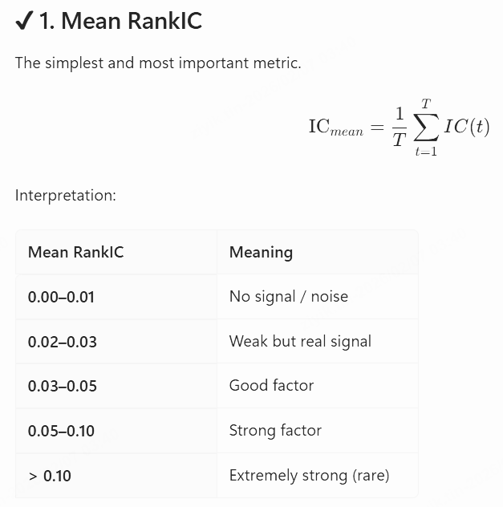
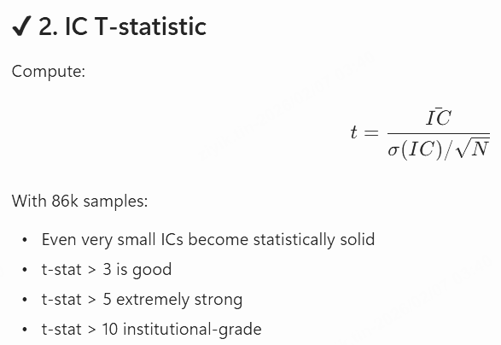
Given RankIC, how to know whether it is a good factor

Slide 13
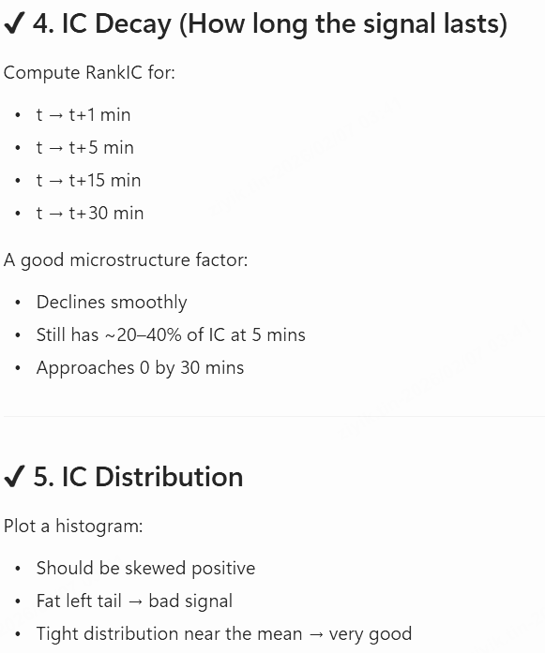
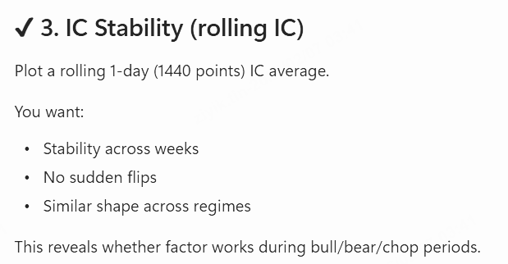
Given RankIC, how to know whether it is a good factor

Slide 14
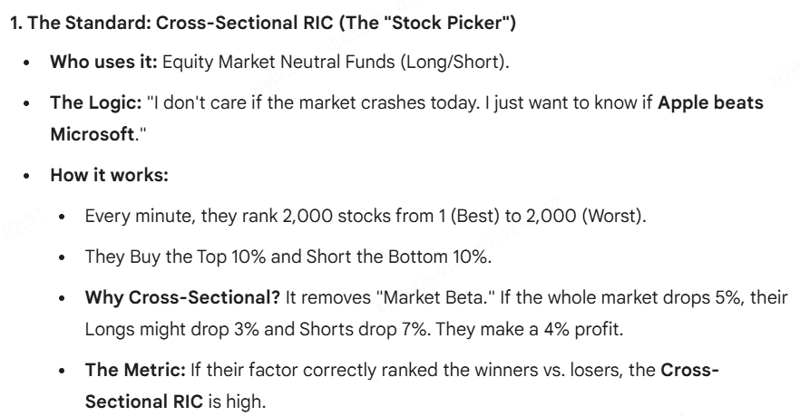
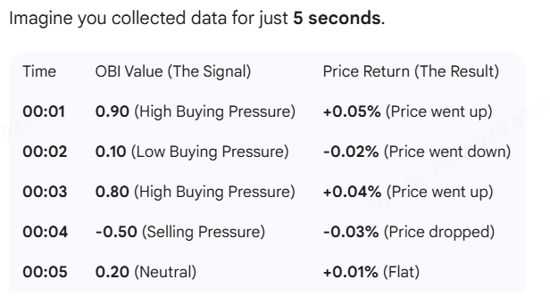
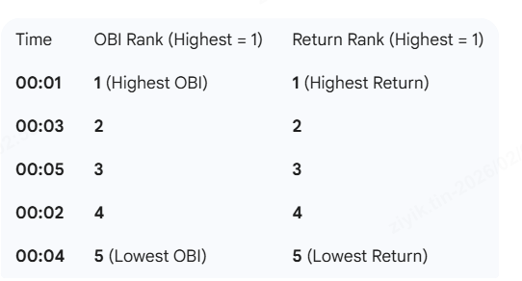
Cross-Sectional RIC V.S. Time Series RIC
Time Series RIC

Slide 15
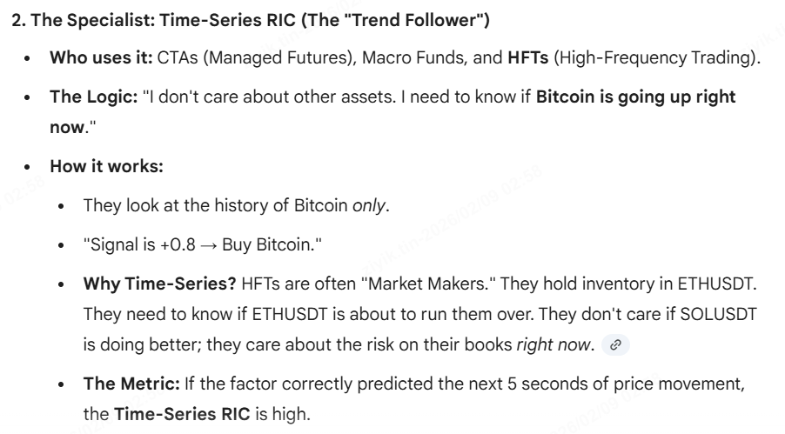
Cross-Sectional RIC V.S. Time Series RIC

Slide 16
Steps
Data Ingestion
Calculate Order Flow Factors Value
Assign Rank for t=x
Find RIC using t=x + lag
Repeat process for n times
Find mean RIC and p-value
RIC > 0.03 = good factor
Calculation of Imformation Ratio
Lead-Lag Analysis

Slide 17
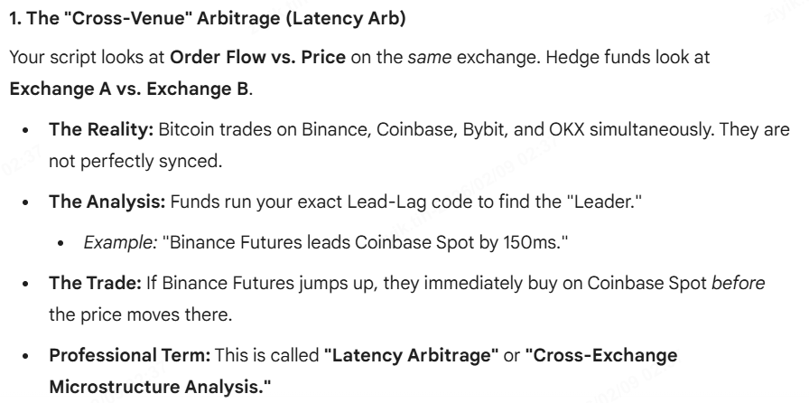
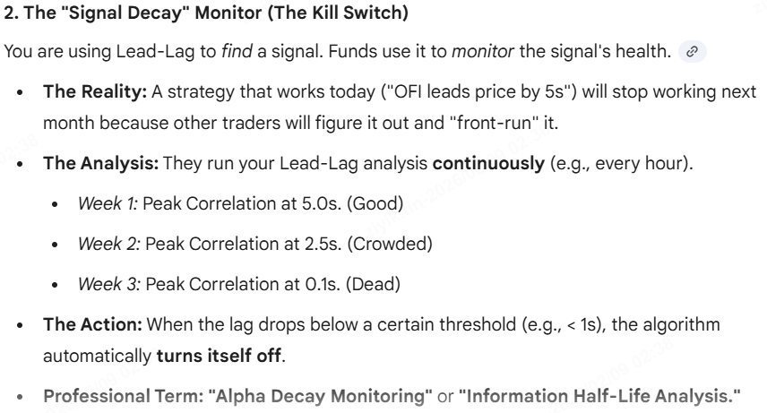
How Real Life Hedge Fund Use Lead Lag Analysis

Slide 18
ORDER FLOW FACTORS
Lists of Order Flow Factors proven useful

Slide 19
Lists of Order Flow Factors proven useful
Rank | Factor Name | Type | Data Needed | What it Predicts | The "Alpha" (Signal)
1 | Order Book Imbalance (OBI) | Static (State) | L2 (Best) or L1 | Directional Pressure | Supply/Demand Ratio: High Bid volume vs. Ask volume pushes price UP. (Path of least resistance).
2 | Trade Flow Imbalance (OFI) | Trade-Only | Trades Only | Momentum & Exhaustion | Taker Sentiment: Who is "hitting" the book harder? Buyers or Sellers? (Actual execution).
3 | Microprice Deviation | Static (State) | L1 (BBO) Only | Mean Reversion / Fair Value | True Price: Adjusts the mid-price based on volume weighting. Detects mispricing before it corrects.
4 | LOBSTER (OFI) | Dynamic (Flow) | L2 (Incremental) | Net Order Flow Intent | The Grand Unifier: Combines Limit Orders + Cancellations + Trades into one "Net Pressure" number.
5 | Replenishment Rate | Dynamic (Flow) | L1/L2 + Trades | Hidden Support/Resistance | Iceberg Detection: "The wall was eaten, but it grew back." Predicts reversals at key levels.
6 | Liquidity Depletion | Dynamic (Flow) | L2 (Incremental) | Spoofing / Breakouts | The Rug Pull: "The wall wasn't eaten; it just vanished." Predicts fake support/resistance failing.
7 | Depth Slope | Static (State) | L2 (Full Book) | Volatility / Impact | Elasticity: How steep is the book? Steep = Stable; Flat = Volatile/Fragile.

Slide 20
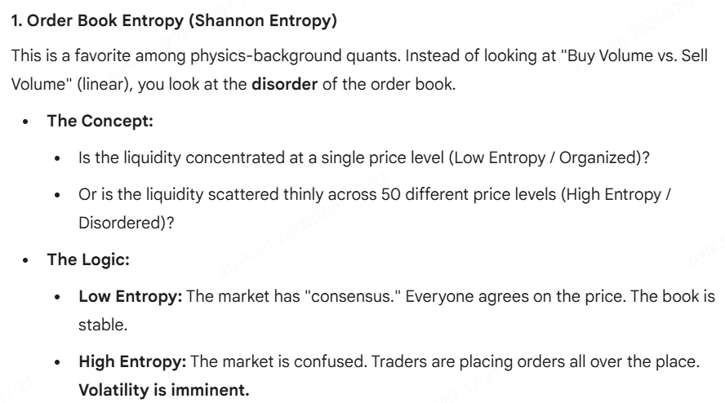
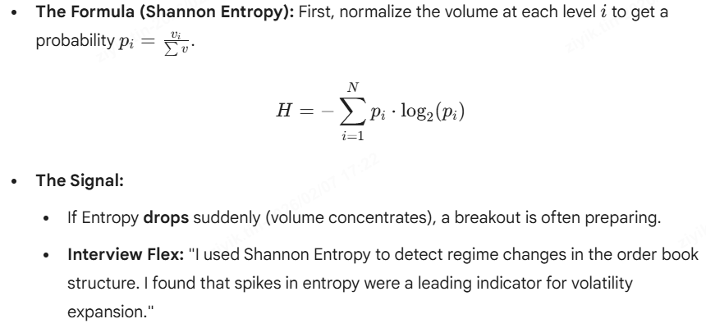
Other Advanced L2 Level Factors
…

Slide 21
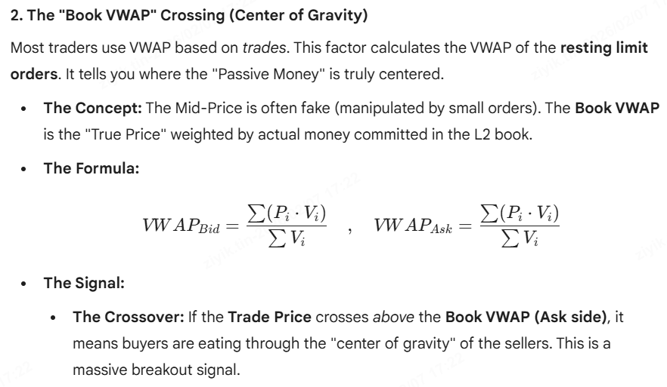
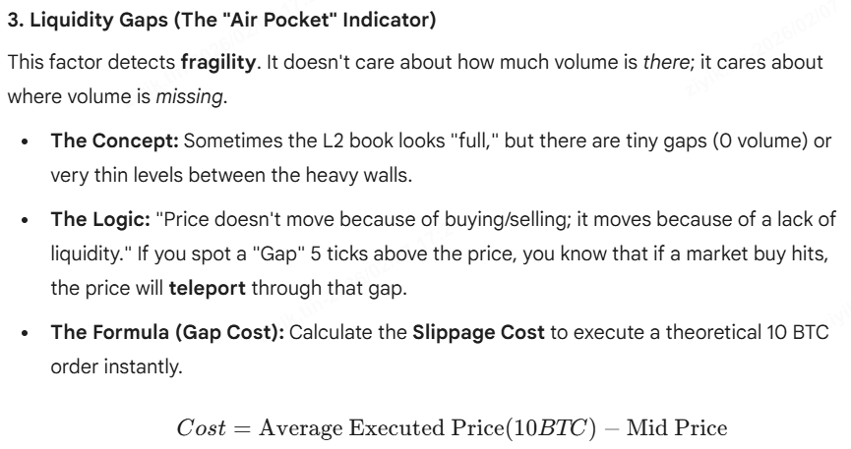
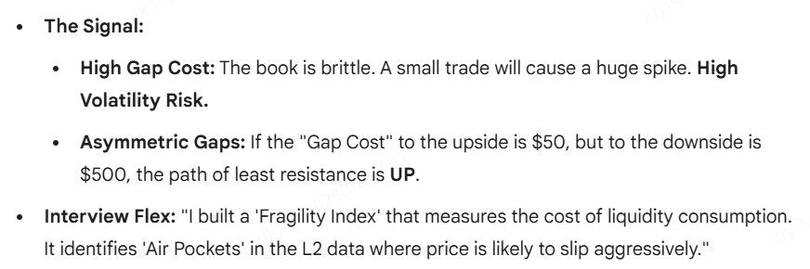
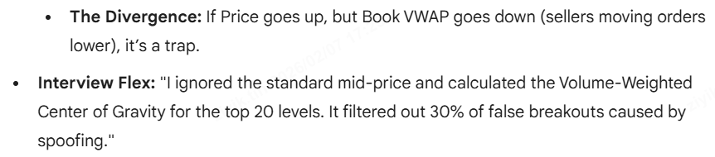
Other Advanced L2 Level Factors
…

Slide 22
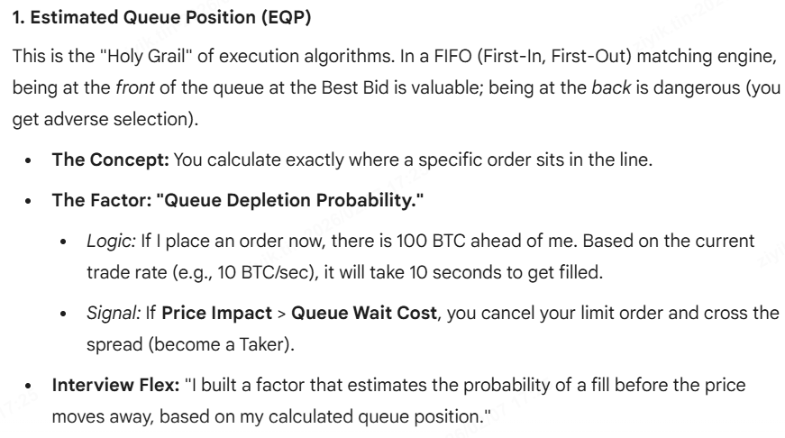
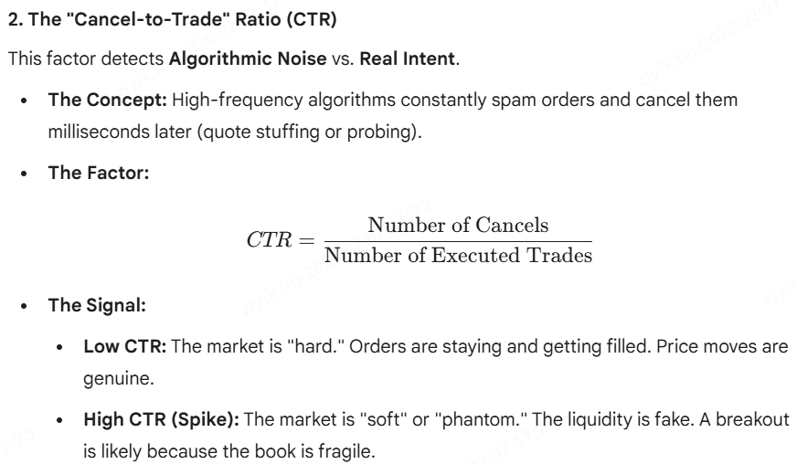
Optional: L3 Level Factors
…

Slide 23
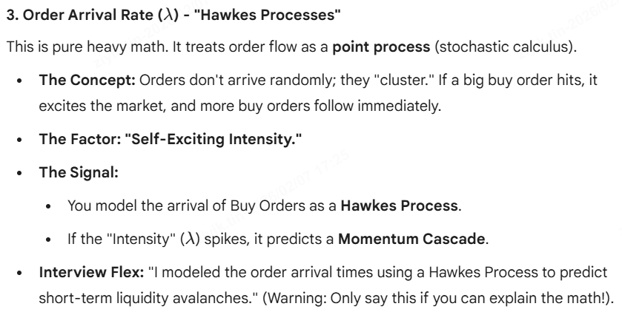
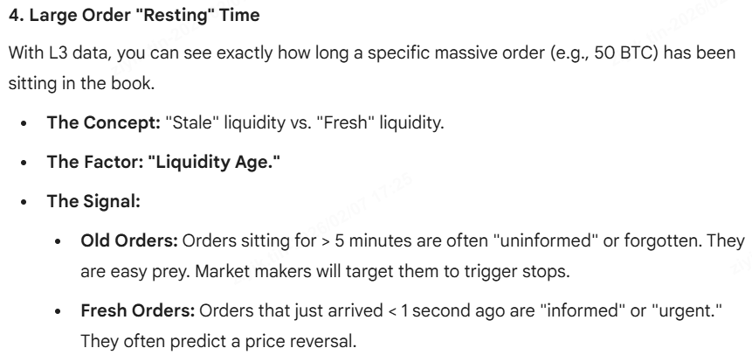
Optional: L3 Level Factors
…

Slide 24
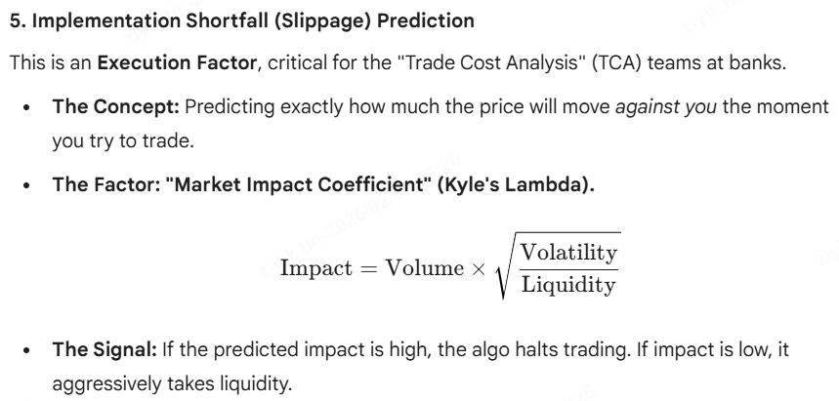
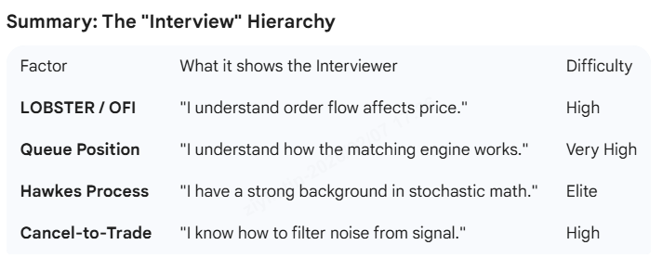
Optional: L3 Level Factors
…

Slide 25


1. Order Book Imbalance Ratio (L1)

Slide 26


1. Order Book Imbalance Ratio
*Recall that ask price is the purchase price
Useful Link: 1. https://arxiv.org/pdf/2112.13213v1
2. https://www.researchgate.net/publication/47860140_The_Price_Impact_of_Order_Book_Events

Slide 27

1. Order Book Imbalance Ratio
Standard OBI has a weakness: Spoofing
Solution: Depth Weighting.
Don't just sum the volume. Give more weight to orders close to the spread and less weight to orders far away.
Modified Formula:

Slide 28


1. Order Book Imbalance Ratio (L2)

Slide 29


2. Microprice Deviation

Slide 30



2. Microprice Deviation

Slide 31

2. Microprice Deviation (optional)

Slide 32


3. Depth Slope (Involve L2 Data)

Slide 33


3. Depth Slope (Involve L2 Data)

Slide 34

3. Depth Slope (Involve L2 Data)

Slide 35




4. Replenishment Rate/Iceberg Detection

Slide 36




4. Replenishment Rate/Iceberg Detection

Slide 37


5. Aggressor Ratio/ Trade Flow Imbalance
While Order Imbalance (OBI) looks at the intent to trade (limit orders), the Aggressor Ratio looks at actual executed trades.
It tells you who is more desperate to trade right now: the buyers or the sellers.

Slide 38

5. Aggressor Ratio/ Trade Flow Imbalance
Like RSI
Don’t need L2

Slide 39


6. L2 Liquidity Depletion Indicator
To detect spoofing

Slide 40


6. L2 Liquidity Depletion Indicator

Slide 41



7. Order Flow Imbalance/LOBSTER factor
Most Important Factor

Slide 42


7. Order Flow Imbalance/LOBSTER factor
Most Important Factor

Slide 43
Other Order Flow Factors Logic
net buying pressure
order imbalance
aggressive vs passive flow
liquidity provision/withdrawal
volume‑synchronized price moves
VPIN / toxicity
market maker inventory pressure
large trader footprints

Slide 44
ACTUAL RUN
L2 Order Book Imbalance (OBI)

Slide 45



Methodology
…

Slide 46

Methodology
…

Slide 47



Transforming L2_OBI Methodology into Code
Snapshot for every 100ms
*L1

Slide 48


Is OBI a useful factor? Yes if OBI change before price change
…
OBI seems to work, but lets run with code

Slide 49




The peak correlation at lag 0 suggests that the primary price discovery occurs within the 100ms sampling interval
Prove profitable if we enter when the correlation is still >0

Slide 50



Do not enter at 3 seconds. That is where the fake-out happens.
Prove profitable if we enter when the correlation is still >0

Slide 51


Run OBI with 10 symbols and compute time series RIC
Since OBI is proven useful….
…

Slide 52



Run OBI with 10 symbols and compute time series RIC
Since OBI is proven useful….
Sample Output:
SYMBOL | L2 RANK IC | P-VALUE | SAMPLES
-------------------------------------------------------
BTCUSDT | 0.3172 ✅ | 0.0004 | 122
ETHUSDT | 0.2106 ✅ | 0.0199 | 122
BNBUSDT | 0.0166 | 0.8564 | 122
SOLUSDT | 0.0858 | 0.3473 | 122
XRPUSDT | 0.1165 | 0.2014 | 122
ADAUSDT | 0.1841 ✅ | 0.0441 | 120
DOGEUSDT | 0.1471 | 0.1060 | 122
SUIUSDT | -0.0981 | 0.2826 | 122
ASTERUSDT | -0.1168 | 0.2000 | 122
AVAXUSDT | 0.0243 | 0.8026 | 108
-------------------------------------------------------
AVERAGE L2 IC: 0.0887

Slide 53
ACTUAL RUN
Order Flow Imbalance/LOBSTER

Slide 54

Order Flow Imbalance/LOBSTER factor

Slide 55



Is OFI a useful factor? Yes if OBI change before price change

Slide 56


Is OFI a useful factor? Yes if OFI change before price change
Perfect line to show that OFI is actually working, just that we don’t have the infrastructure to do HFT

Slide 57


Run OFI with 10 symbols and compute time series RIC
Since L1 OFI is proven useful….

Slide 58

Run OFI with 10 symbols and compute time series RIC
Since L1 OFI is proven useful….

Slide 59


Run OFI with 10 symbols and compute time series RIC
Since L1 OFI is proven useful….

Slide 60

Run OFI with 10 symbols and compute time series RIC
Since L1 OFI is proven useful….

Slide 61




L2 OFI: Looks worse than L1 OFI. WHY?

Slide 62




L2 is better than L1?

Slide 63


L2 in crypto VS. L2 in US stock market

Slide 64

Queue Imbalance Factor for Stock Market

Slide 65


Quick Test!

Slide 66

Quick Test!

Slide 67
ACTUAL RUN
Aggressor Ratio / Trade Flow Imbalance

Slide 68




Trade Flow Imbalance

Slide 69
Trade Flow Imbalance
While Order Imbalance (OBI) looks at the intent to trade (limit orders), the Aggressor Ratio looks at actual executed trades.
It tells you who is more desperate to trade right now: the buyers or the sellers.

Slide 70


Trade Flow Imbalance
Like RSI
Don’t need L2

Slide 71


Trade Flow Imbalance Result

Slide 72


Trade Flow Imbalance Result

Slide 73


Trade Flow Imbalance Result

Slide 74
Machine Learning in Order Flow Analysis
AI

Slide 75

DeepLOB
Machine Learning in Order Flow Analysis

Slide 76


Moving from Linear to Non-Linear
Involving Machine Learning in Order Flow Analysis

Slide 77


DeepLOB
Problem and Solution
DeepLOB Pytorch Repo: https://github.com/Jeonghwan-Cheon/lob-deep-learning

Slide 78


DeepLOB

Slide 79


DeepLOB

Slide 80



Dive deeper into the blackbox

Slide 81




Dive deeper into the blackbox

Slide 82


Dive deeper into the blackbox

Slide 83

Dive deeper into the blackbox

Slide 84



Demo of how the neural network processes the data

Slide 85


Demo of how the neural network processes the data

Slide 86




Demo of how the neural network processes the data
Four types of file is needed:

Slide 87


Demo of how the neural network processes the data
The result is not satisfying because the “brain” is made with a highly stable set of stocks, which makes the “brain” output that it’s better not to buy or sell

Slide 88




Is the DeepLOB hedge fund level yet?
…

Slide 89


Is the DeepLOB hedge fund level yet?
…

Slide 90
Machine Learning in Order Flow Analysis
Others

Slide 91


Other ML topics
Involving Machine Learning in Order Flow Analysis

Slide 92


Other more advanced topics
Involving Machine Learning in Order Flow Analysis

Slide 93
Other more advanced topics
…

Slide 94
Things Missing
Technical Analysis using kernel regression

Slide 95



Project To-Do

Slide 96


Project To-Do: Kernel Regression

